Slide 1

Group 29
Manpreet kaur, David Junior, Mahirul Islam, Favour Cole(Missing), Zainab Patel, Taran Singh, Khurrum Arif, maclain apsley-turner

Slide 2

kHURRUM ARIF (Ka382)
IBM SkillsBuild is an online learning platform which offers courses in leading and emerging technologies.

Slide 3

kHURRUM ARIF (Ka382)
The web application is made to enhance the learning experience by gamified elements.
What the application offers and its' features.
Impact of the web application

Slide 4

David SARKODIE JUNIOR (DOJS1) – Allocation of work
Identifying Strengths
Division of team
Assignment of work
Adaptability

Slide 5

David SARKODIE JUNIOR (DOJS1) – Allocation of work Was it a success
Members with heavier workloads
Partially complete user stories
Better clarity

Slide 6
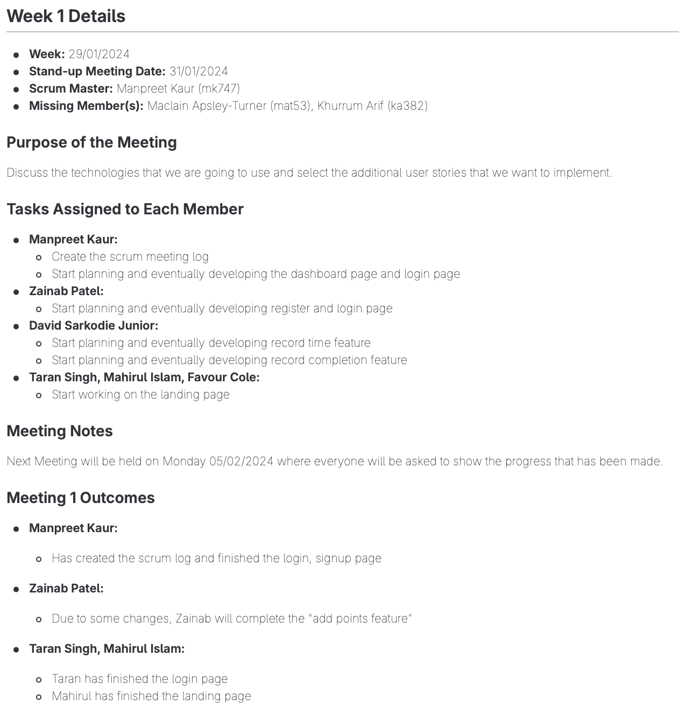
Zainab Patel(zp81) – scrum events
Meeting frequency
Met weekly
On campus or group call
Meeting Structure
Tasks completed, next steps and concerns addressed
Setting main goal for coming week
Scrum Log
Utilising GitLab
Contents of the log
Successes and Improvements
Met frequently
Rotated scrum master role
Distribution of responsibility

Slide 7

Mahirul islam (mi210) - How the Group Communicated
What were our communication methods?
Real-Life Weekly Meetings
Main WhatsApp Group Chat
Help Chat

Slide 8

Mahirul islam (mi210) - How the Group Communicated
Purpose and the benefits of our communication methods?
Real-Life Weekly Meetings
Purpose: Discuss progress, make strategic decisions.
Benefits: Enhance collaboration, provide immediate feedback, and maintain accountability.
Main WhatsApp Group Chat
Purpose: Daily updates and announcements.
Benefits: Provides easy access to updates, quickly share information, and keeps a record for future reference.
Help Chat
Purpose: Technical assistance and problem-solving support.
Benefits: Creates a supportive environment that allows quick problem solving.

Slide 9

Mahirul islam (mi210) - How the Group Communicated
Lessons Learned from Our Communication Methods
Importance of Face-to-face meetings when making major decisions.
Having a supportive environment where you can ask for help improves the groups efficiency.
Affective communication allowed our group to monitor responsibilities and progress, ensuring everyone stayed on track.

Slide 10
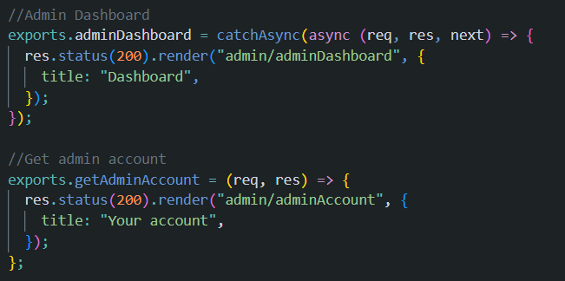
Manpreet Kaur(mk747) - A software design decision
What is Node.js?
Open-source, cross-platform JavaScript runtime environment that executes JavaScript code outside of a web browser and is designed to build scalable network applications

Slide 11
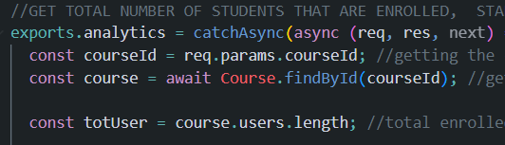
Manpreet Kaur(mk747) - A software design decision
Why Node.js?
Flexible
Performance
Ecosystem

Slide 12
Manpreet Kaur(mk747) - A software design decision
Why Node.js?
Resource Efficiency
Scalability

Slide 13
Taran singh (ts444)- non-technical skills learned during the project
•Conflict Resolution: Resolving disagreements and conflicts that arise within the team in a constructive manner, fostering better collaboration and productivity.
•Professionalism: Meeting expectations and respecting team members.
•Self-Management: Taking ownership of your tasks, managing your workload independently, and staying motivated and focused throughout the project duration.
•Feedback Incorporation: Actively incorporating feedback received from peers, mentors, or clients into project improvements, demonstrating a commitment to continuous learning and growth.
•Adaptability: Flexibly responding to changing requirements and dynamics.

Slide 14

Maclain apsley-turner (Mat53) - Social, legal & ethical
Social Issues:
Content Moderation: Managing User-Generated Content
User Engagement and Addiction: Designing Gamification
Digital Divide: Enforcing Equity

Slide 15

Maclain apsley-turner (Mat53) - Social, legal & ethical
Ethical Issues:
Fair Access: Social Inclusivity
Review and Feedback System: Correct Use of Management
Control Over Personal Information: Managing Accounts

Slide 16

Maclain apsley-turner (Mat53) - Social, legal & ethical
Legal Issues:
Data Protection & Privacy: Complying with GDPR
Intellectual Property: Correct Licensing
User Agreements: ToS and Privacy Policy

Slide 17
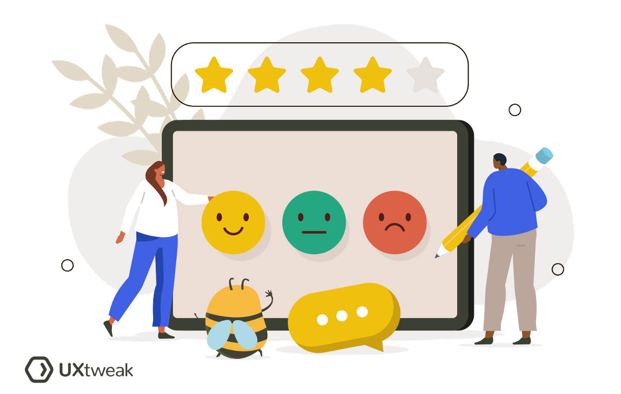
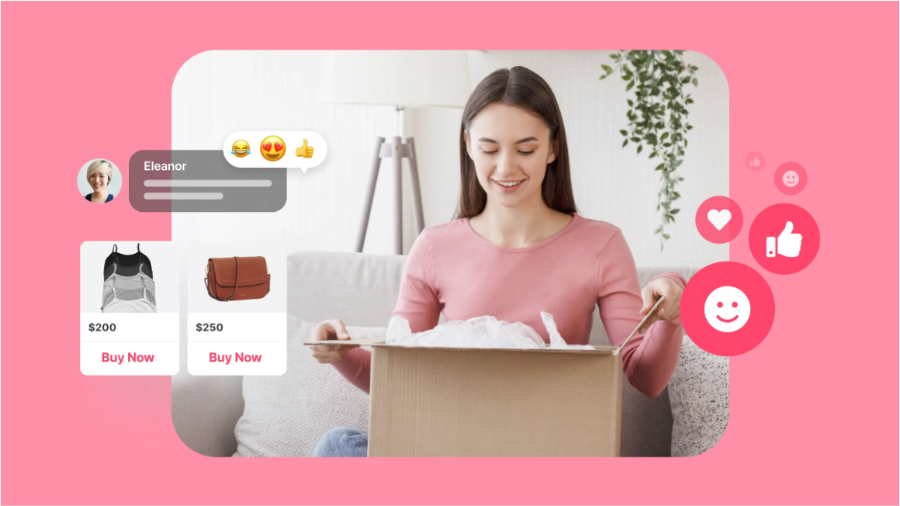
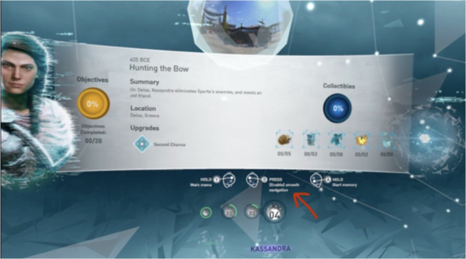



Realistic plans to take this project onwards fAVOUR COLE (FC182)
1.To maximize the efficiency and performance of the web app and to keep a close eye on user engagement metrics like active users, completion rates, and feedback surveys.
2.Include extra gamification components such as interactive tests, customized learning routes, and milestone awards.
3.Guarantee smooth navigation between the online application and the learning platform and to expedite integration with SkillsBuild.
4.Extend social aspects including interacting with classmates, exchanging accomplishments, and taking part in team activities.
5.Include tools for interactive progress visualization, personalized recommendations, and real-time progress tracking.
6.Ensuring that the SkillsBuild platform is maintained and updated regularly to consider changing user needs, technology breakthroughs, and platform modifications.
7.Perform user testing and gather feedback to find areas that need work and fix usability problems.

Slide 18

Thank You

